Slide 1
Hunter Gatherer
Prototype Task

Slide 2
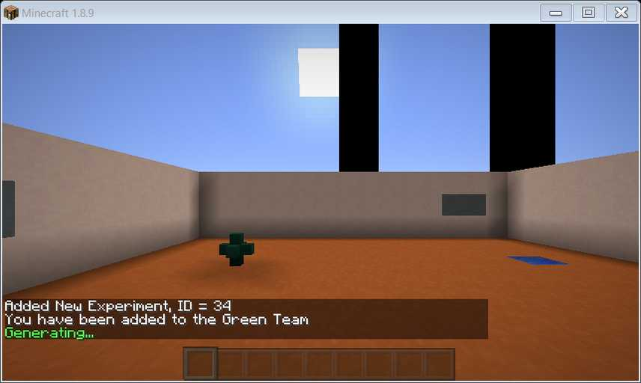
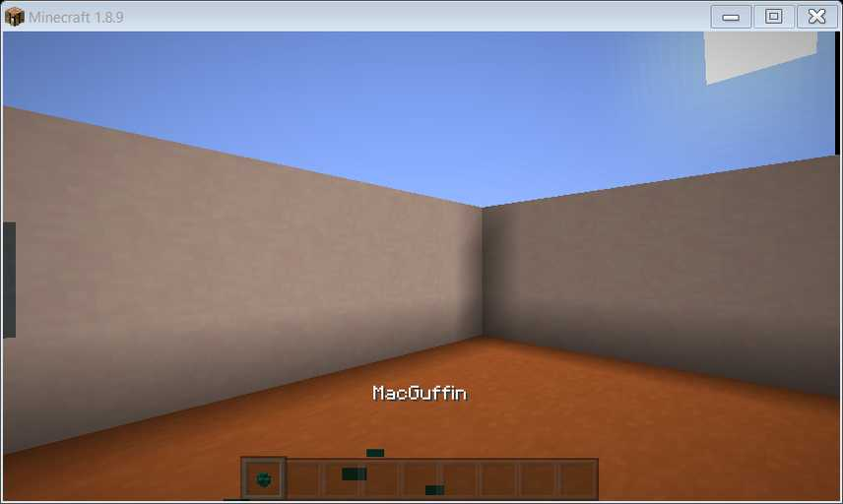
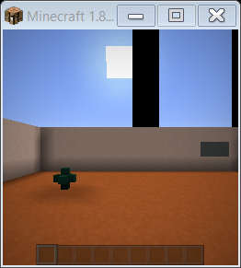
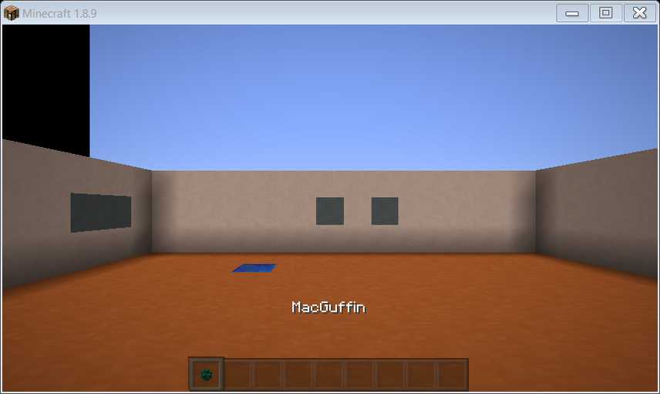
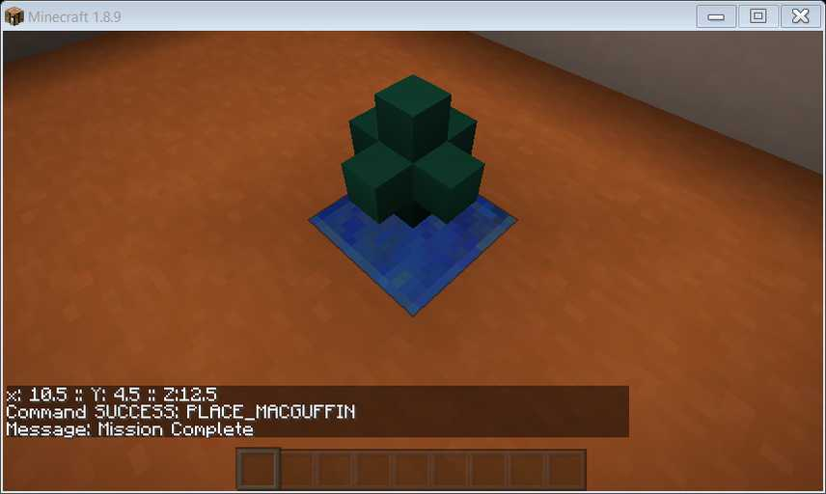
Prototype (Minimally viable environment)
See the MacGuffin
Get the MacGuffin
See the Target
Put the MacGuffin at the Target
1
2
3
4
Actual size

Slide 3
Task Notes
MacGuffin appearance is always in block form (placed in the world)
No starting position indication will be under the block, as pictured
No Break command required (currently) – MacGuffin is automatically gathered when agent reaches it
Display of health, experience and hunger is hidden
Display of hand and current item is hidden
Inventory hot bar is visible
Arena has Internal reference marks (gray marks on wall), External reference marks (black towers in background), Global reference marks (sun)
Time and weather are disabled

Slide 4
Hunter-Gatherer Interaction Spaces
Action Space
Percept Space
Meta: START, RESET
SENSE_SCREEN (Provides a single snapshot of the screen)
SENSE_ALL
SENSE_INVENTORY
SENSE_LOCATIONS
Tank commands:
SMOOTH_MOVE [W,A,D,X,Q,E,Z,C]
SMOOTH_TURN [15 degree increments]
SMOOTH_TILT [FORWARD, DOWN]
PLACE_MACGUFFIN (at BlockInFront)
Visual Field (by SENSE_SCREEN & all tank commands)
256x256 pixels
Pixel/Integer array using GL12.GL_BGRA, GL12.GL_UNSIGNED_INT_8_8_8_8_REV
World State (by SENSE_ALL)
Various JSON
Inventory (by SENSE_INVENTORY)
Player inventory state
Locations (by SENSE_LOCATIONS)
Player, Target, MacGuffin
Previous Operation Success
SENSE_*, PLACE_MACGUFFIN, Tank commands

Slide 5
Meta: START and RESET
START initiates the world and joins a player to the world
RESET initiates an experiment:
RESET domain ../experiments/hgv1_0.psm

Slide 6
SENSE_SCREEN
Provides a current snapshot of the player’s field of vision
Format:
Pixel/Integer array
using GL12.GL_BGRA, GL12.GL_UNSIGNED_INT_8_8_8_8_REV
256x256 pixels
Pictured at right is actual window resolution

Slide 7
SENSE_ALL
Full output example on next slide
“BlockInFront”
Block where player will act (PLACE_*)
“inventory”
Player inventory
“damage” is metadata; may not make sense in all cases
“Player”
“entities”
Would have coordinates for entities. N/A to this task
“map”
“blocks” is a list of all blocks at knee height in order north->south, then east->west (see next slide)
“size” is the size of the space listed, to determine orientation
“origin” is the location of the first item listed, in the south-east corner of the map
{
"BlockInFront":{
"name":"minecraft:log",
"axis":"y",
"variant":"oak"
},
"inventory":{
"0":{
"item":"minecraft:log",
"count":1,
"damage":0,
"maxdamage":0
},
"1":{
"item":"polycraft:bag_polyisoprene_pellets",
"count":1,
"damage":0,
"maxdamage":0
}
},
"Player":{
"pos":[
2,
4,
3
],
"facing":"EAST",
"yaw":15,
“pitch":0
},
"entities":{
},
"map":{
"blocks":[
"minecraft:bedrock",
"minecraft:bedrock",
"minecraft:bedrock",
...
"minecraft:air",
"minecraft:air",
"minecraft:bedrock",
"minecraft:bedrock",
"minecraft:air",
"minecraft:log",
"minecraft:crafting_table",
"minecraft:air",
"minecraft:air",
"minecraft:bedrock",
"minecraft:bedrock",
"minecraft:bedrock",
"minecraft:bedrock",
"minecraft:bedrock",
"minecraft:bedrock",
"minecraft:bedrock",
"minecraft:bedrock"
],
"size":[
7,
1,
7
]
“origin":[
0,
5,
0
]
}
}

Slide 8
SENSE_ALL
{
"BlockInFront":{
"name":"minecraft:log",
"axis":"y",
"variant":"oak"
},
"inventory":{
"0":{
"item":"minecraft:log",
"count":1,
"damage":0,
"maxdamage":0
},
"1":{
"item":"polycraft:bag_polyisoprene_pellets",
"count":1,
"damage":0,
"maxdamage":0
}
},
"Player":{
"pos":[
2,
4,
3
],
"facing":"EAST",
"yaw":15,
“pitch":0
},
"entities":{
},
"map":{
"blocks":[
"minecraft:bedrock",
"minecraft:bedrock",
"minecraft:bedrock",
"minecraft:bedrock",
"minecraft:bedrock",
"minecraft:bedrock",
"minecraft:bedrock",
"minecraft:bedrock",
"minecraft:air",
"minecraft:air",
"minecraft:air",
"minecraft:air",
"minecraft:air",
"minecraft:bedrock",
"minecraft:bedrock",
"minecraft:air",
"minecraft:air",
"minecraft:air",
"minecraft:air",
"minecraft:air",
"minecraft:bedrock",
"minecraft:bedrock",
"minecraft:air",
"minecraft:air",
"minecraft:log",
"minecraft:air",
"minecraft:air",
"minecraft:bedrock",
"minecraft:bedrock",
"minecraft:air",
"minecraft:air",
"minecraft:air",
"minecraft:air",
"minecraft:air",
"minecraft:bedrock",
"minecraft:bedrock",
"minecraft:air",
"minecraft:air",
"minecraft:air",
"minecraft:air",
"minecraft:air",
"minecraft:bedrock",
"minecraft:bedrock",
"minecraft:bedrock",
"minecraft:bedrock",
"minecraft:bedrock",
"minecraft:bedrock",
"minecraft:bedrock",
"minecraft:bedrock"
],
"size":[
7,
1,
7
]
“origin":[
0,
5,
0
]
}
}

Slide 9
SENSE_ALL Block Order Clarification
"map":{
"blocks":[
“x",
“x",
“O",
“x",
“x",
“x",
“ ",
“ ",
“ ",
“x",
“x",
“ ",
“ ",
“ ",
“x",
“x",
“ ",
“ ",
“ ",
“x",
“x",
“x",
“x",
“x",
“x",
“x"
],
"size":[
5,
1,
5
]
“origin":[
0,
0,
0
]
}
}
[4 0 0]
[4 0 4]
East
[↑ 0 0 | 270 0]
x | x | x | x | x
x |  |  |  | x
x |  |  |  | x
x |  |  |  | x
x | x | O | x | x
North
[0 0 ↓ | 180 0]
South
[0 0 ↑ | 0 0]
[0 0 0]
[0 0 4]
West
[↓ 0 0 | 90 0]

Slide 10
SENSE_ALL NONAV
Alternative to SENSE_ALL
Provides blocks with names (given by location). JSON order is not reliable.
Not recommended for use with this task, but available.
{
"BlockInFront":{
"name":"minecraft:air"
},
"inventory":{
"0":{
"item":"minecraft:planks",
"count":2,
"damage":0,
"maxdamage":0
},
"1":{
"item":"polycraft:tree_tap",
"count":1,
"damage":0,
"maxdamage":0
}
},
"Player":{
"pos":[
2,
4,
3
],
"facing":"SOUTH"
},
"entities":{
},
"map":{
"0,4,0":{
"name":"minecraft:bedrock"
},
"0,4,1":{
"name":"minecraft:bedrock"
},
"0,4,2":{
"name":"minecraft:bedrock"
},
...
"5,4,6":{
"name":"minecraft:bedrock"
},
"6,4,0":{
"name":"minecraft:bedrock"
},
...
"6,4,6":{
"name":"minecraft:bedrock"
}
}
}

Slide 11
SENSE_INVENTORY
Items in Inventory
Damage is a multi-use field.
{
"inventory":{
"0":{
"item":“polycraft:macguffin",
"count":1,
"damage":0,
"maxdamage":0
},
"1":{
"item":" minecraft:planks ",
"count":1,
"damage":0,
"maxdamage":0
},
“2":{
"item":"polycraft:tree_tap",
"count":1,
"damage":0,
"maxdamage":0
},
}
}

Slide 12
SENSE_LOCATIONS
Player
Pos: Position in the world
Facing: Cardinal direction
Yaw: Player yaw in degrees
Pitch: Player pitch in degrees
MacGuffinPos: location of MacGuffin on ground.
Destination position: Location to deliver MacGuffin
{
"Player":{
"pos":[
2,
4,
3
],
"facing":"EAST",
"yaw":15,
“pitch":0
},
“MacGuffinPos“: [
6,
4,
5
],
“DestinationPos":[
2,
3,
2
]
}

Slide 13
Movement
Tank commands are ego-centric
Following slides contain visual descriptions
Smooth motion (interpolated frames) is in development
SMOOTH_MOVE [W,A,D,X,Q,E,Z,C]
“Strafing” = view angles do not change during SMOOTH_MOVE
Move 1 block per call
If travel will be diagonal, either block between can block agent
SMOOTH_TURN <Angle>
Angle may be positive (to the right) or negative (to the left)
Angle must be a multiple of 15
SMOOTH_TILT [FORWARD, DOWN]
Forward will look to the horizon
Down will look to the ground in front of the player
Result
Success
All: {“command”:”[COMMAND]”,”result”:”success”, "Player":{"pos":[2,4,3],"facing":"EAST","yaw":15,“pitch":0}}
Failure
SMOOTH_MOVE: {“command”:”[COMMAND]”,”result”:”fail”,”reason”:[“Location occupied” (checked first) | “Diagonal movement is obscured by [block type] at [position]” (only one block will be listed) | “indeterminate”]}
Others: {“command”:”[COMMAND]”,”result”:”fail”,”reason”:”indeterminate”}

Slide 14
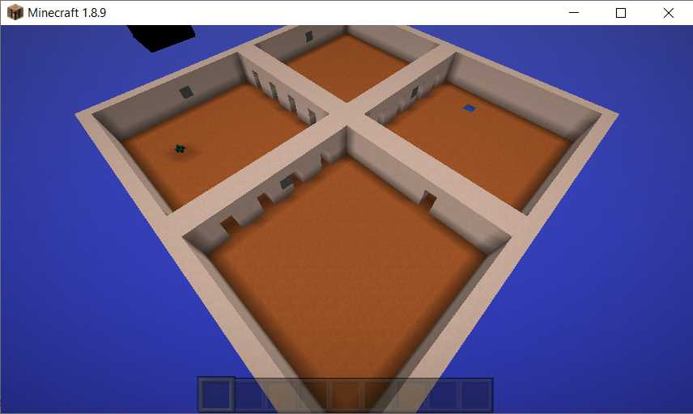
Movement: Translation
W
Q
E
A
D
Z
C
X
SMOOTH_MOVE [W,A,D,X,Q,E,Z,C]
- Θ
+ Θ
SMOOTH_TURN [+/- Θ]

Slide 15
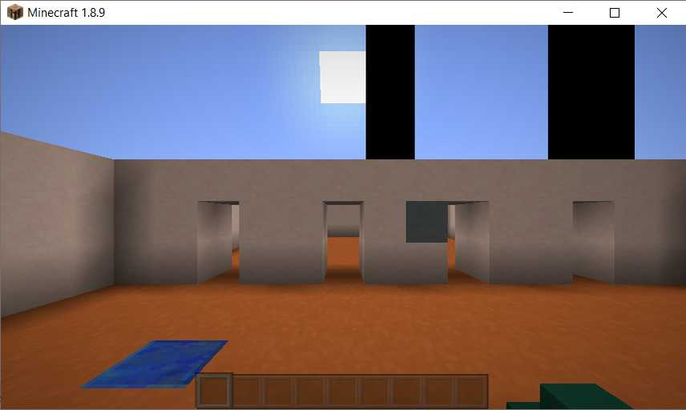
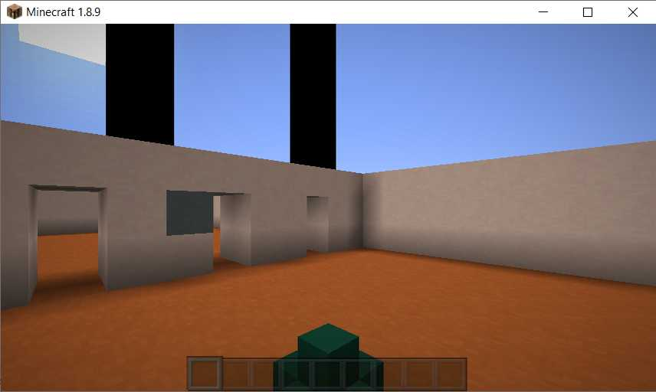
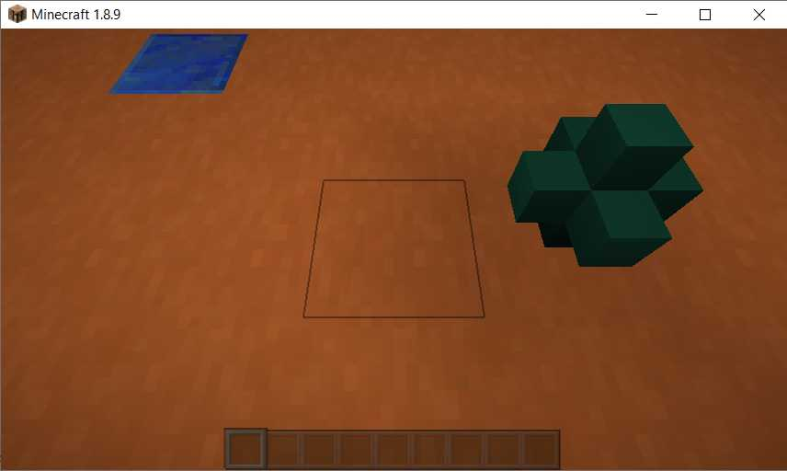
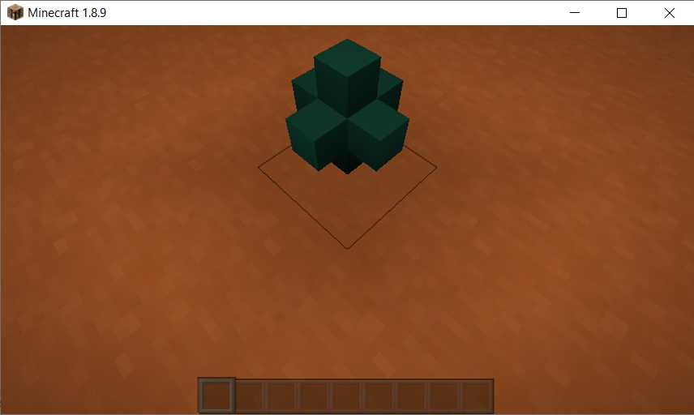
Movement: Turn and Tilt
SMOOTH_TILT
FORWARD
SMOOTH_TURN [+/-] 45
(Yaw)
(Pitch)
SMOOTH_TILT
DOWN

Slide 16
Movement: Diagonal Notes 1
 | 2 | 4
 | 1 | 3
SMOOTH_MOVE, being egocentric, depends on the direction the agent is facing. When facing a cardinal direction or 15° away (orange tones), the forward direction is orthogonal. When facing an intercardinal direction or 15° away (blue tones), the forward direction is diagonal.

Slide 17
Movement: Diagonal Notes 2
 | 2 | 4
 | 1 | 3
Diagonal movement:
For the agent to move from position 1 to position 4, both positions 2 and 3 must be empty of blocks

Slide 18
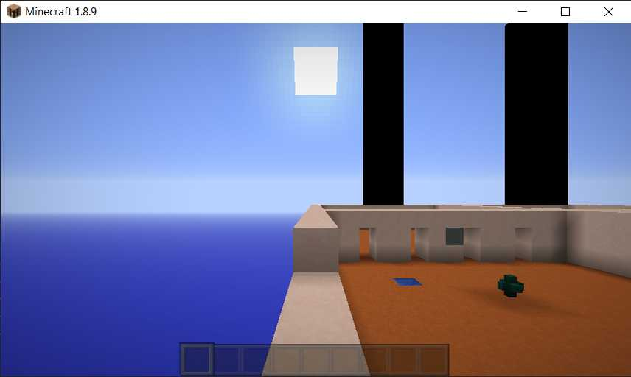
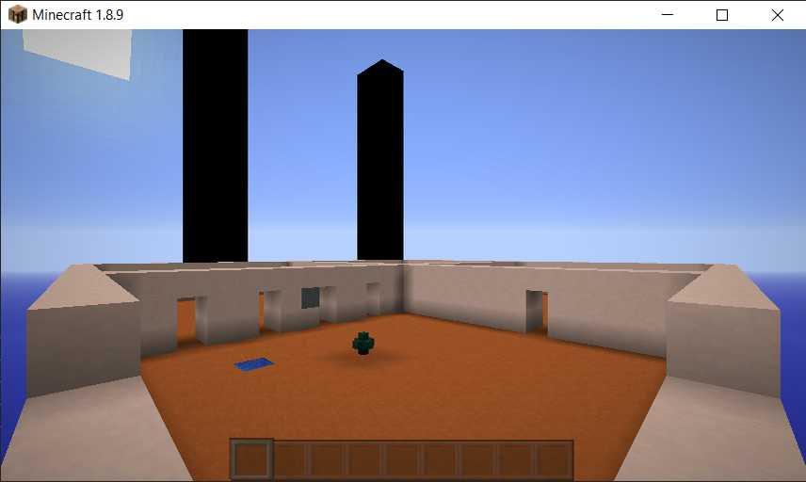
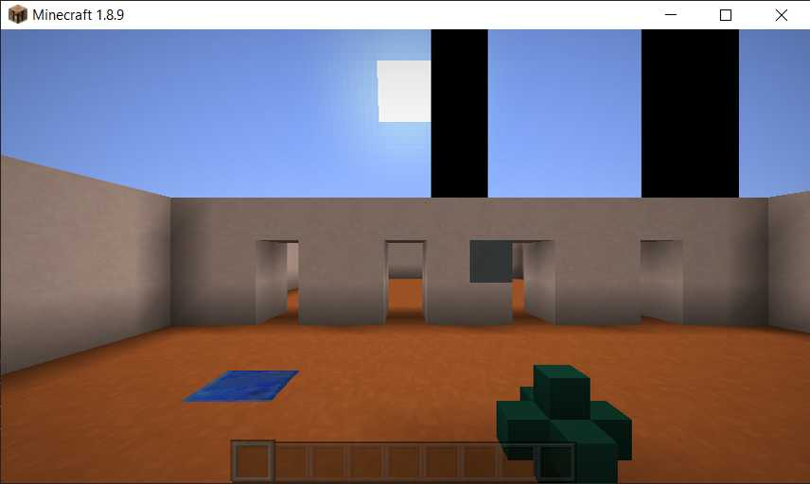
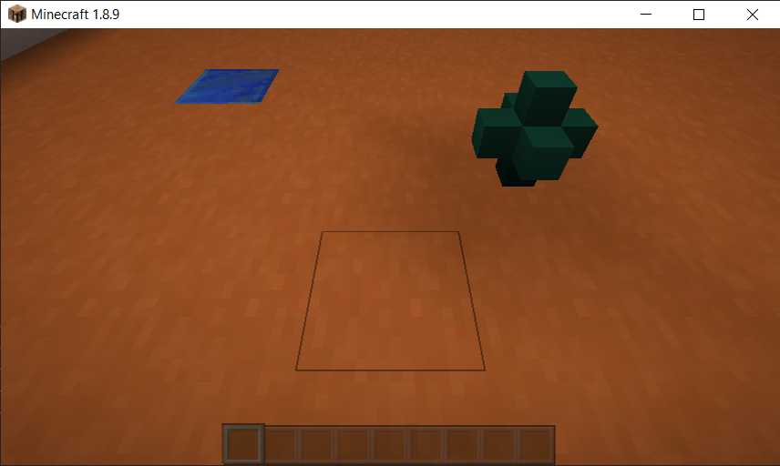
Notes on Minecraft Weird World Coordinates
Coordinate order and direction is often counter-intuitive
[X Y Z | Yaw Pitch]
East
[↑ 0 0 | 270 0]
A
B
Move Up
[0 ↑ 0 | 0 0]
North
[0 0 ↓ | 180 0]
South
[0 0 ↑ | 0 0]
Move Down
[0 ↓ 0 | 0 0]
[0 6 0 | 270 0]
[0 6 0 | 315 0]
West
[↓ 0 0 | 90 0]
Tilt Forward
[0 0 0 | 0 ↓]
C
D
Turn Left
[0 0 0 | ↓ 0]
Turn Right
[0 0 0 | ↑ 0]
Tilt Down
[0 0 0 | 0 ↑]
[7 4 6 | 270 0]
[7 4 6 | 270 50]
Notes:
Tilt arrows are correct – looking down is a POSITIVE pitch
A -> B is a change in Yaw
C -> D is a change in Pitch
A -> C is a change in position (X, Y, & Z)

Slide 19
PLACE_MACGUFFIN
Places MacGuffin in front of player (“BlockInFront” location)
Result:
Success
{“command”:”PLACE_MACGUFFIN]”,”result”:”success”}
Failure
{“command”:”PLACE_MACGUFFIN”,”result”:”fail”,”reason”:“Location unavailable”}
E.g. The “BlockInFront” is not air
{“command”:”PLACE_MACGUFFIN”,”result”:”fail”,”reason”:“Wrong location”}

Slide 20
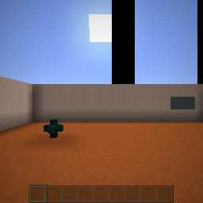
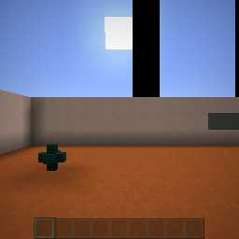
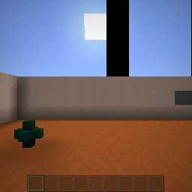
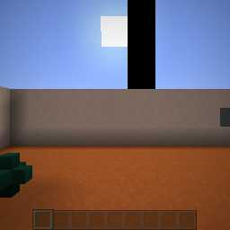
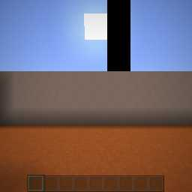
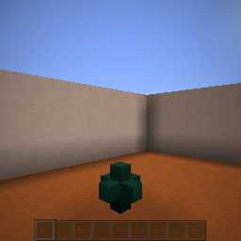
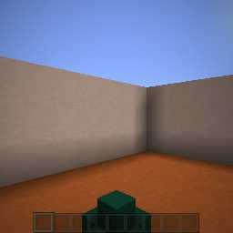
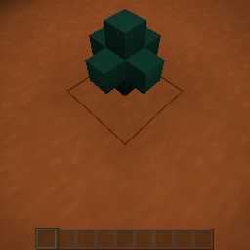
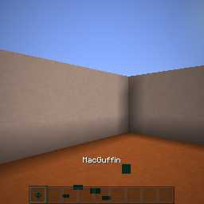
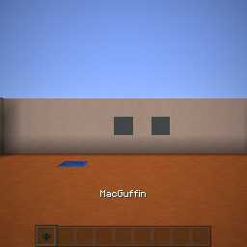
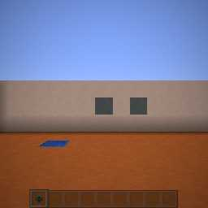
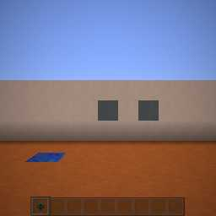
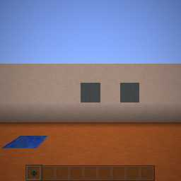
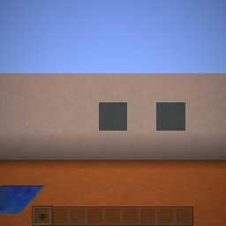
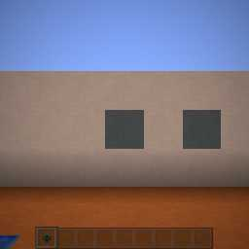
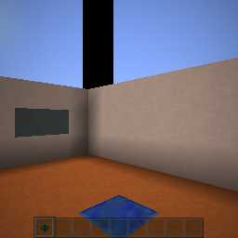
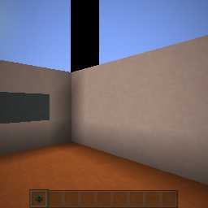
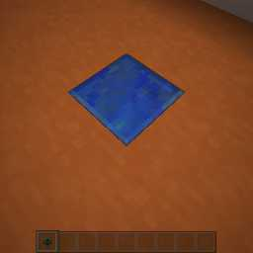
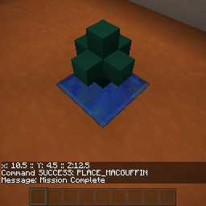
Prototype Solution
RESET domain ../experiments/ hgv1_0.psm
2.-6.MOVE W (x5)
TURN -45
MOVE W
TILT DOWN
MOVE W (gets the MacGuffin)
TURN 135
12-16. MOVE W (x6)
TURN -45
MOVE W
TILT DOWN
PLACE_MACGUFFIN

